Slide 1
Chapter 04 – Selection of an appropriate project approach
SOFTWARE
PROJECT MANAGEMENT

Slide 2
Outline of lecture
Building versus buying software
Taking account of the characteristics of the project
Process models
  Waterfall
  Prototyping and iterative approaches
  Incremental delivery
Agile approaches
Notes:
Topics covered
Professional software development
What is meant by software engineering.
Software engineering ethics
A brief introduction to ethical issues that affect software engineering.
Suggested student projects
A brief introduction to each suggested project that can be carried out by students for this course

Slide 3
Selection of project approaches
This lecture concerned with choosing the right approach to a particular project: variously called technical planning, project analysis, methods engineering and methods tailoring
In-house: often the methods to be used dictated by organizational standards
Suppliers: need for tailoring as different customers have different needs
Notes:
Topics covered
Professional software development
What is meant by software engineering.
Software engineering ethics
A brief introduction to ethical issues that affect software engineering.
Suggested student projects
A brief introduction to each suggested project that can be carried out by students for this course

Slide 4
Build or buy?
In-house development
Outsource
No
Yes
Either
Build
Buy
Notes:
Topics covered
Professional software development
What is meant by software engineering.
Software engineering ethics
A brief introduction to ethical issues that affect software engineering.
Suggested student projects
A brief introduction to each suggested project that can be carried out by students for this course

Slide 5
Some advantages of off-the-shelf (OTS) software
Cheaper as supplier can spread development costs over a large number of customers
Software already exists
  Can be trialled by potential customer
  No delay while software being developed
Where there have been existing users, bugs are likely to have been found and eradicated
5
Notes:
Topics covered
Professional software development
What is meant by software engineering.
Software engineering ethics
A brief introduction to ethical issues that affect software engineering.
Suggested student projects
A brief introduction to each suggested project that can be carried out by students for this course

Slide 6
Some possible disadvantages of off-the- shelf
Customer will have same application as everyone else: no competitive advantage, but competitive advantage may come from the way application is used
Customer may need to change the way they work in order to fit in with OTS application
Customer does not own the code and cannot change it
Danger of over-reliance on a single supplier
Notes:
Topics covered
Professional software development
What is meant by software engineering.
Software engineering ethics
A brief introduction to ethical issues that affect software engineering.
Suggested student projects
A brief introduction to each suggested project that can be carried out by students for this course

Slide 7
General approach
Look at risks and uncertainties e.g.
  are requirement well understood?
  are technologies to be used well understood?
Look at the type of application being built e.g.
  information system? embedded system?
  criticality? differences between target and development environments?
Clients’ own requirements
  need to use a particular method
Notes:
Topics covered
Professional software development
What is meant by software engineering.
Software engineering ethics
A brief introduction to ethical issues that affect software engineering.
Suggested student projects
A brief introduction to each suggested project that can be carried out by students for this course

Slide 8
Structure versus speed of delivery
Structured approach
Also called ‘heavyweight’ approaches
Step-by-step methods where each step and intermediate product is carefully defined
Emphasis on getting quality right first time
Example: use of UML and USDP
Future vision: Model-Driven Architecture (MDA). UML supplemented with Object Constraint Language, press the button and application code generated from the UML/OCL model
Notes:
Topics covered
Professional software development
What is meant by software engineering.
Software engineering ethics
A brief introduction to ethical issues that affect software engineering.
Suggested student projects
A brief introduction to each suggested project that can be carried out by students for this course

Slide 9
Structure versus speed of delivery
Agile methods
Emphasis on speed of delivery rather than documentation
RAD Rapid application development emphasized use of quickly developed prototypes
JAD Joint application development. Requirements are identified and agreed in intensive workshops with users
Notes:
Topics covered
Professional software development
What is meant by software engineering.
Software engineering ethics
A brief introduction to ethical issues that affect software engineering.
Suggested student projects
A brief introduction to each suggested project that can be carried out by students for this course

Slide 10
Choice of process models
‘waterfall’ also known as ‘one-shot’, ‘once-through’
incremental delivery
evolutionary development
Also use of ‘agile methods’ e.g. extreme programming
Notes:
Topics covered
Professional software development
What is meant by software engineering.
Software engineering ethics
A brief introduction to ethical issues that affect software engineering.
Suggested student projects
A brief introduction to each suggested project that can be carried out by students for this course

Slide 11
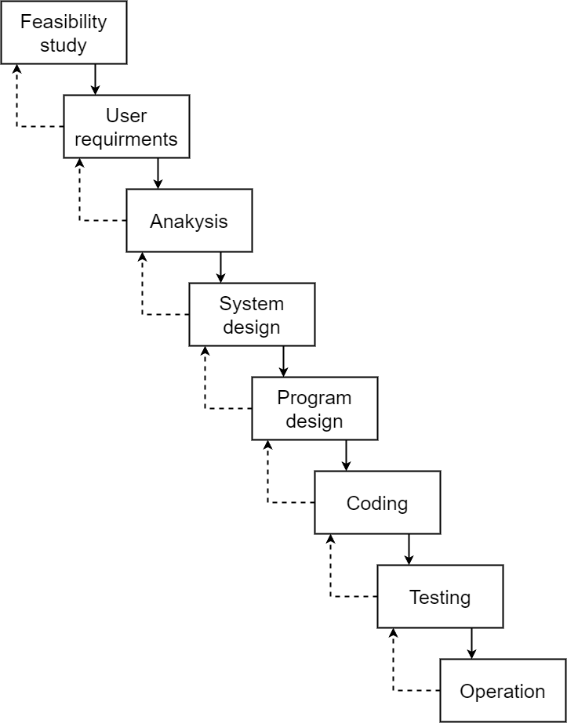
Waterfall
Notes:
Topics covered
Professional software development
What is meant by software engineering.
Software engineering ethics
A brief introduction to ethical issues that affect software engineering.
Suggested student projects
A brief introduction to each suggested project that can be carried out by students for this course

Slide 12
Waterfall
the ‘classical’ model
imposes structure on the project
every stage needs to be checked and signed off
BUT
  limited scope for iteration
V model approach is an extension of waterfall where different testing phases are identified which check the quality of different development phases
Notes:
Topics covered
Professional software development
What is meant by software engineering.
Software engineering ethics
A brief introduction to ethical issues that affect software engineering.
Suggested student projects
A brief introduction to each suggested project that can be carried out by students for this course

Slide 13
evolutionary delivery: prototyping
‘An iterative process of creating quickly and inexpensively live and working models to test out requirements and assumptions’
Sprague and McNurlin
main types
‘throw away’ prototypes
evolutionary prototypes
what is being prototyped?
human-computer interface
functionality
Notes:
Topics covered
Professional software development
What is meant by software engineering.
Software engineering ethics
A brief introduction to ethical issues that affect software engineering.
Suggested student projects
A brief introduction to each suggested project that can be carried out by students for this course

Slide 14
reasons for prototyping
learning by doing
improved communication
improved user involvement
a feedback loop is established
reduces the need for documentation
reduces maintenance costs i.e. changes after the application goes live
prototype can be used for producing expected results
Notes:
Topics covered
Professional software development
What is meant by software engineering.
Software engineering ethics
A brief introduction to ethical issues that affect software engineering.
Suggested student projects
A brief introduction to each suggested project that can be carried out by students for this course

Slide 15
prototyping: some dangers
users may misunderstand the role of the prototype
lack of project control and standards possible
additional expense of building prototype
focus on user-friendly interface could be at expense of machine efficiency
Notes:
Topics covered
Professional software development
What is meant by software engineering.
Software engineering ethics
A brief introduction to ethical issues that affect software engineering.
Suggested student projects
A brief introduction to each suggested project that can be carried out by students for this course

Slide 16
other ways of categorizing prototyping
what is being learnt?
  organizational prototype
  hardware/software prototype (‘experimental’)
  application prototype (‘exploratory’)
to what extent
  mock-ups
  simulated interaction
  partial working models: vertical versus horizontal
Notes:
Topics covered
Professional software development
What is meant by software engineering.
Software engineering ethics
A brief introduction to ethical issues that affect software engineering.
Suggested student projects
A brief introduction to each suggested project that can be carried out by students for this course

Slide 17
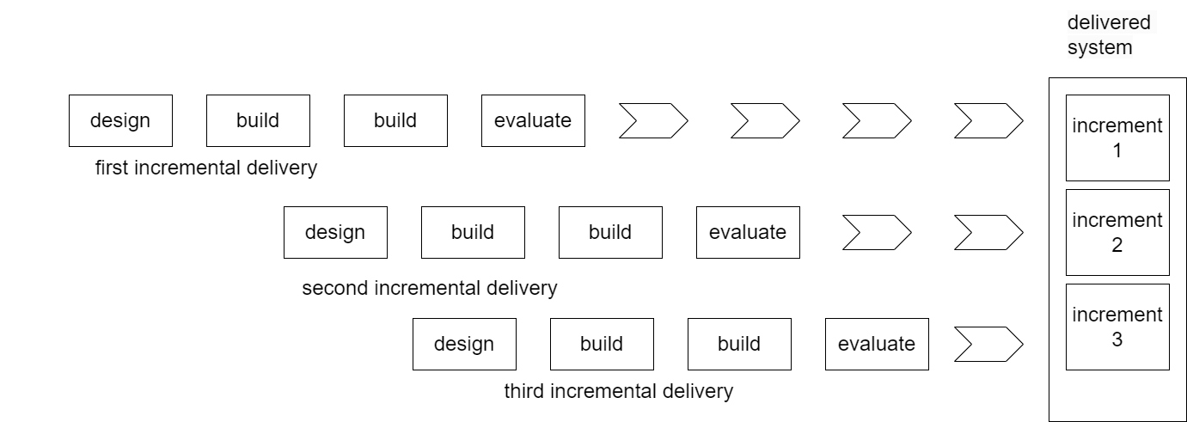
Incremental delivery
Figure 3: Incremental delivery approach
Notes:
Topics covered
Professional software development
What is meant by software engineering.
Software engineering ethics
A brief introduction to ethical issues that affect software engineering.
Suggested student projects
A brief introduction to each suggested project that can be carried out by students for this course

Slide 18
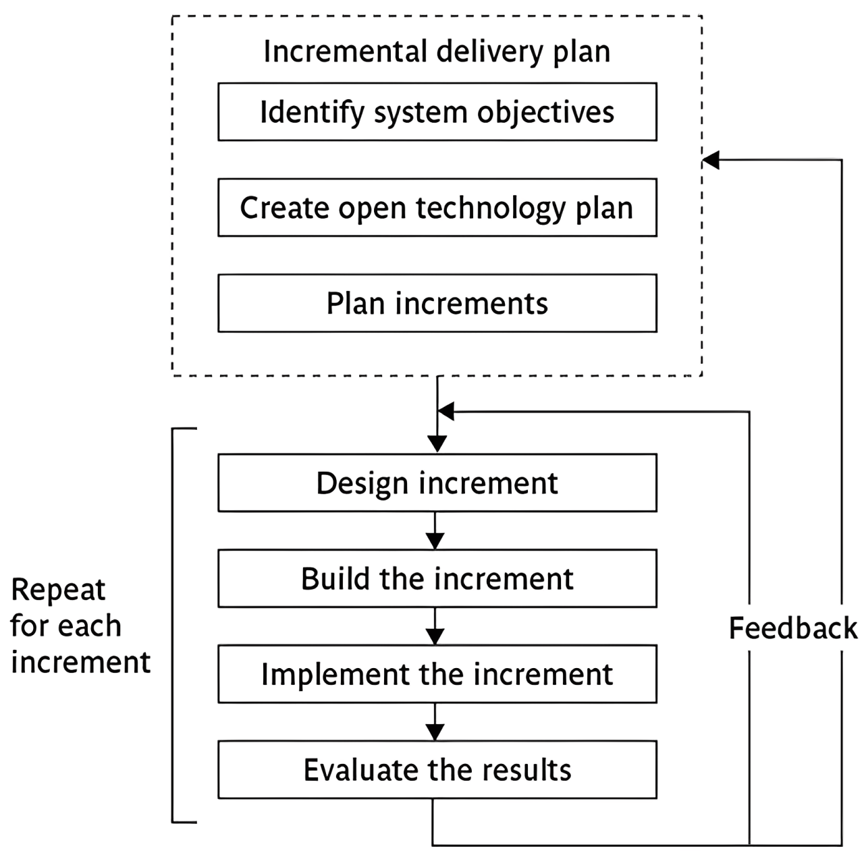
the incremental process
Figure 4: Intentional incremental delivery
Notes:
Topics covered
Professional software development
What is meant by software engineering.
Software engineering ethics
A brief introduction to ethical issues that affect software engineering.
Suggested student projects
A brief introduction to each suggested project that can be carried out by students for this course

Slide 19
incremental approach:benefits
feedback from early stages used in developing latter stages
shorter development thresholds
user gets some benefits earlier
project may be put aside temporarily
reduces ‘gold-plating’:
BUT there are some possible disadvantages
loss of economy of scale
‘software breakage’
Notes:
Topics covered
Professional software development
What is meant by software engineering.
Software engineering ethics
A brief introduction to ethical issues that affect software engineering.
Suggested student projects
A brief introduction to each suggested project that can be carried out by students for this course

Slide 20
the outline incremental plan
Steps ideally 1% to 5% of the total project
Non-computer steps should be included
ideal if a step takes one month or less:
  not more than three months
each step should deliver some benefit to the user
some steps will be physically dependent on others
Notes:
Topics covered
Professional software development
What is meant by software engineering.
Software engineering ethics
A brief introduction to ethical issues that affect software engineering.
Suggested student projects
A brief introduction to each suggested project that can be carried out by students for this course

Slide 21
which step first?
some steps will be pre-requisite because of physical dependencies
others may be in any order
value to cost ratios may be used
  V/C where
  V is a score 1-10 representing value to customer
  C is a score 0-10 representing value to developers
Notes:
Topics covered
Professional software development
What is meant by software engineering.
Software engineering ethics
A brief introduction to ethical issues that affect software engineering.
Suggested student projects
A brief introduction to each suggested project that can be carried out by students for this course

Slide 22
V/C ratios: an example
Step | Value | Cost | Ratio
Profit reports | 9 | 1 | 9 | 2nd
Online database | 1 | 9 | 0.11 | 5th
Ad hoc enquiry | 5 | 5 | 1 | 4th
Purchasing plans | 9 | 4 | 2.25 | 3rd
Profit – based pay for managers | 9 | 0 | inf | 1st
Notes:
Topics covered
Professional software development
What is meant by software engineering.
Software engineering ethics
A brief introduction to ethical issues that affect software engineering.
Suggested student projects
A brief introduction to each suggested project that can be carried out by students for this course

Slide 23
‘Agile’ methods
structured development methods have some perceived
Advantages
  produce large amounts of documentation which can be unread
  documentation has to be kept up to date
  division into specialist groups and need to follow procedures stifles communication
  users can be excluded from decision process
  long lead times to deliver anything etc. etc
The answer? Agile methods?
Notes:
Topics covered
Professional software development
What is meant by software engineering.
Software engineering ethics
A brief introduction to ethical issues that affect software engineering.
Suggested student projects
A brief introduction to each suggested project that can be carried out by students for this course

Slide 24
Atern/Dynamic system development method (DSDM)
UK-based consortium
arguably DSDM can be seen as replacement for SSADM
DSDM is more a project management approach than a development approach
Can still use DFDs, LDSs etc!
An update of DSDM has been badged as ‘Atern’
Notes:
Topics covered
Professional software development
What is meant by software engineering.
Software engineering ethics
A brief introduction to ethical issues that affect software engineering.
Suggested student projects
A brief introduction to each suggested project that can be carried out by students for this course

Slide 25
Six core Atern/DSDM principles
Focus on business need
Delivery on time – use of time-boxing
Collaborate
Never compromise qualitiy
Deliver iteratively
Build incrementally
Notes:
Topics covered
Professional software development
What is meant by software engineering.
Software engineering ethics
A brief introduction to ethical issues that affect software engineering.
Suggested student projects
A brief introduction to each suggested project that can be carried out by students for this course

Slide 26
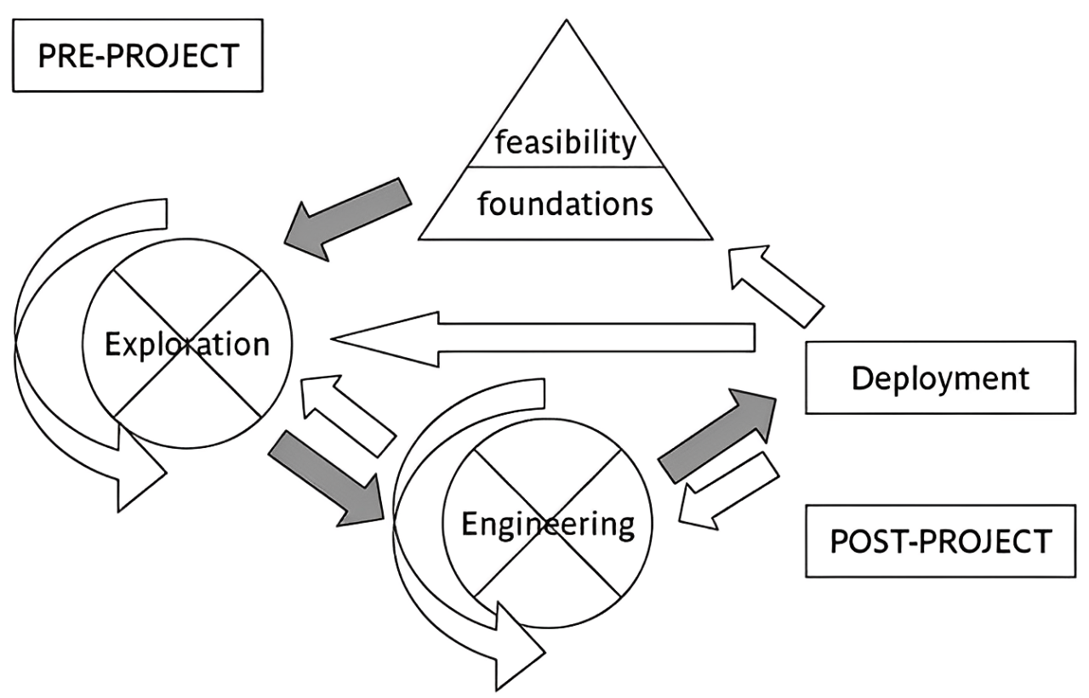
Atern/DSDM framework
Notes:
Topics covered
Professional software development
What is meant by software engineering.
Software engineering ethics
A brief introduction to ethical issues that affect software engineering.
Suggested student projects
A brief introduction to each suggested project that can be carried out by students for this course

Slide 27
Atern DSDM: time-boxing
time-box fixed deadline by which something has to be delivered
typically two to six weeks
MOSCOW priorities
  Must have - essential
  Should have - very important, but system could operate without
  Could have
  Want - but probably won’t get!
Notes:
Topics covered
Professional software development
What is meant by software engineering.
Software engineering ethics
A brief introduction to ethical issues that affect software engineering.
Suggested student projects
A brief introduction to each suggested project that can be carried out by students for this course

Slide 28
Extreme programming
increments of one to three weeks
  customer can suggest improvement at any point
argued that distinction between design and building of software are artificial
code to be developed to meet current needs only
frequent re-factoring to keep code structured
Notes:
Topics covered
Professional software development
What is meant by software engineering.
Software engineering ethics
A brief introduction to ethical issues that affect software engineering.
Suggested student projects
A brief introduction to each suggested project that can be carried out by students for this course

Slide 29
extreme programming - contd
developers work in pairs
test cases and expected results devised before software design
after testing of increment, test cases added to a consolidated set of test cases
Notes:
Topics covered
Professional software development
What is meant by software engineering.
Software engineering ethics
A brief introduction to ethical issues that affect software engineering.
Suggested student projects
A brief introduction to each suggested project that can be carried out by students for this course

Slide 30
Limitations of extreme programming
Reliance on availability of high quality developers
Dependence on personal knowledge – after development knowledge of software may decay making future development less easy
Rationale for decisions may be lost e.g. which test case checks a particular requirement
Reuse of existing code less likely
Notes:
Topics covered
Professional software development
What is meant by software engineering.
Software engineering ethics
A brief introduction to ethical issues that affect software engineering.
Suggested student projects
A brief introduction to each suggested project that can be carried out by students for this course

Slide 31
Grady Booch’s concern
Booch, an OO authority, is concerned that with requirements driven projects:
‘Conceptual integrity sometimes suffers because this is little motivation to deal with scalability, extensibility, portability, or reusability beyond what any vague requirement might imply’
Tendency towards a large number of discrete functions with little common infrastructure?
Notes:
Topics covered
Professional software development
What is meant by software engineering.
Software engineering ethics
A brief introduction to ethical issues that affect software engineering.
Suggested student projects
A brief introduction to each suggested project that can be carried out by students for this course

Slide 32
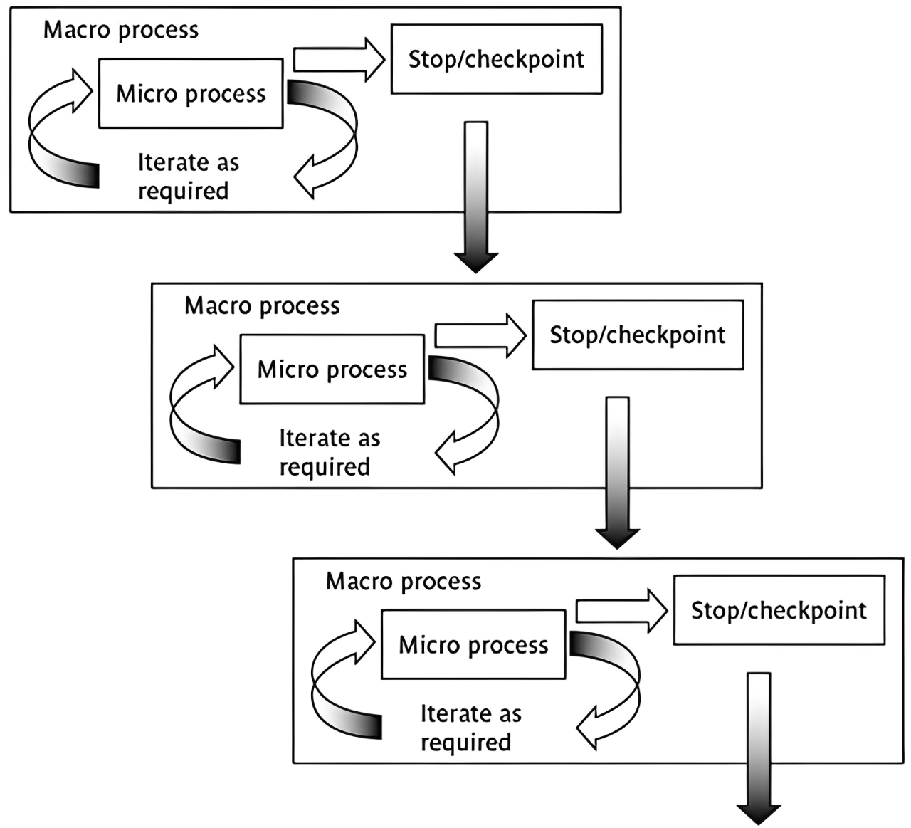
macro and micro processes
Notes:
Topics covered
Professional software development
What is meant by software engineering.
Software engineering ethics
A brief introduction to ethical issues that affect software engineering.
Suggested student projects
A brief introduction to each suggested project that can be carried out by students for this course

Slide 33
combinations of approach
installation
 | One-shot | Incremental | Evolutionary
One-shot | Yes | Yes | No
Incremental | Yes | Yes | No
Evolutionary | Yes | Yes | Yes
construction
one-shot or incremental installation - any construction approach possible
evolutionary installation implies evolutionary construction
Notes:
Topics covered
Professional software development
What is meant by software engineering.
Software engineering ethics
A brief introduction to ethical issues that affect software engineering.
Suggested student projects
A brief introduction to each suggested project that can be carried out by students for this course

Slide 34
‘rules of thumb’ about approach to be used
IF uncertainty is high
THEN use evolutionary approach
IF complexity is high but uncertainty is not
THEN use incremental approach
IF uncertainty and complexity both low
THEN use one-shot
IF schedule is tight
THEN use evolutionary or incremental
Notes:
Topics covered
Professional software development
What is meant by software engineering.
Software engineering ethics
A brief introduction to ethical issues that affect software engineering.
Suggested student projects
A brief introduction to each suggested project that can be carried out by students for this course

